Slide 1

American Express – CREDIT RISK MODELING
Viyang Shah
Dhaivat Khatri
Harshil Patel

Slide 2
EXECUTIVE SUMMARY
Objective: The goal is to refine and establish a machine learning model that can accurately classify and identify accounts that are at risk of default when using American Express credit cards.
Significance: Improving lending policies to reduce defaults will lead to increased revenue in American Express Credit Portfolio.
Outcomes: Implementing a conservative approach with the XGBoost model has proven to enhance revenue. This approach is recommended when economic conditions are uncertain, and minimizing defaults is crucial. Our calculations suggest that the optimal threshold for a cautious strategy is 0.3, resulting in a default rate of 4.37% and yielding revenue of $1,237 per customer per month for the Test 2.
 | Train |  |  | Test 1 |  |  | Test 2
Threshold​ | # Total – accepted​ | Default Rate​ | Revenue​ | # Total – accepted​ | Default Rate​ | Revenue​ | # Total – accepted​ | Default Rate​ | Revenue​
Conservative Strategy (0.3 threshold) | 117,456 | 4.37% | $ 1,237 | 24,666 | 4.60% | $ 1,224 | 25,672 | 4.37% | $ 1,237
Aggressive Strategy (0.5 threshold) | 185,135 | 8.05% | $ 1,283 | 38,878 | 8.00% | $ 1,272 | 40,465 | 8.05% | $ 1,283

Slide 3
DATA selection
A 13-month period, from March 2017 to April 2018, was covered by the data we chose. This period perfectly captures the economic dynamics we are currently seeing, particularly the rise in interest rates and inflation after a period of zero interest rates.
Total Entries: 5531451 entries
Truncated Data Size (20%): 1109662 entries
Unique Customer_ID Values: 92051 (20% 0f labels)
One-Hot Encoding:
Columns Before: 191 , Columns After: 226
Data Types After Merge:
Float64: 185, Int64: 2, Object: 4
Data Types After One-Hot Encoding:
Datetime64: 1, Float64: 175. Int64: 1, Object: 2, Uint8: 48
Category | # of Observations | Default Rate
App. with 13 mo. of Historical Data | 77226 | 0.2273
App. with 12 mo. of Historical Data | 2187 | 0.2088
App. with 11 mo. of Historical Data | 1171 | 0.2162
App. with 10 mo. of Historical Data | 1354 | 0.2475
App. with 9 mo. of Historical Data | 1326 | 0.2386
App. with 8 mo. of Historical Data | 1214 | 0.2603
App. with 7 mo. of Historical Data | 1036 | 0.2812
App. with 6 mo. of Historical Data | 1084 | 0.3077
App. with 5 mo. of Historical Data | 940 | 0.3148
App. with 4 mo. of Historical Data | 878 | 0.2716
App. with 3 mo. of Historical Data | 1128 | 0.2588
App. with 2 mo. of Historical Data | 1229 | 0.2644
App. with 1 mo. of Historical Data | 1009 | 0.2190

Slide 4
FEATURES
Category | # of Features | Description
Delinquency Variables (D_*) | 96 | Delinquency refers to the failure of a borrower to make timely payments on a loan or debt obligation. When a borrower becomes delinquent, it means they have missed one or more scheduled payments.
Spend Variables (S_*) | 22 | "Spend" typically refers to the amount of money spent by an individual or entity during a specific period.
Payment Variables (P_*) | 3 | "Payment" refers to the amount of money a borrower pays back to a lender as part of their loan or credit card repayment. It includes both the principal amount borrowed and any applicable interest or fees.
Balance Variables (B_*) | 40 | "Balance" refers to the remaining amount of debt owed by a borrower on a loan or credit card.
Risk Variables (R_*) | 28 | A "risk variable" is a factor or characteristic used in credit risk assessment and credit scoring models to evaluate the creditworthiness of a borrower.
*A column designated “Customer_ID” and “S_2” are excluded from the above table. They hold information regarding ID and date of statement, respectively.

Slide 5
FEATURE ENGINEERING
Category
Average of Variable Column (previous 3 months)
Average of Variable Column (previous 6 months)
Average of Variable Column (previous 9 months)
Average of Variable Column (12 months)
Maximum of Variable Column (previous 12 months)
Minimum of Variable Column (previous 12 months)
Sum of Variable Column (previous 6 months)
Sum of Variable Column (previous 12 months)
Min of Variable Column(previous 12 months)

Slide 6
FEATURE ENGINEERING (Top 5 SHAP Values)
create new variables that capture important patterns and relationships
Feature | Min | 1 Percentile | 5 Percentile | Median | 95 Percentile | 99 Percentile | Max | Mean | % Missing
P_2 | -3.842365e-01 | 2.099578e-03 | 2.193785e-01 | 0.692709 | 9.758549e-01 | 1.005786e+00 | 1.010000e+00 | 6.548719e-01 | 0.83
B_1 | -3.842365e-01 | 5.014059e-04 | 2.145469e-03 | 0.031710 | 6.071315e-01 | 1.010397e+00 | 1.324057e+00 | 1.250896e-01 | 0
B_9 | 3.883418e-08 | 2.283948e-04 | 1.145970e-03 | 0.026247 | 0.651467 | 1.002445 | 25.98335 | 0.190152 | 0
R_1 | 8.059843e-09 | 0.000116 | 0.000586 | 0.005785 | 0.507452 | 1.009294 | 3.0049 | 0.079456 | 0
B_3 | 8.528496e-08 | 0.000255 | 0.01218 | 0.009830 | 0.711462 | 1.008619 | 1.556270 | 0.134106 | 0.033

Slide 7
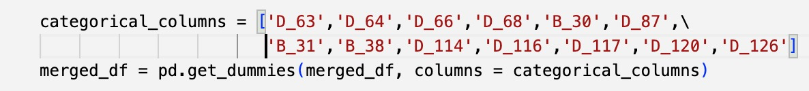
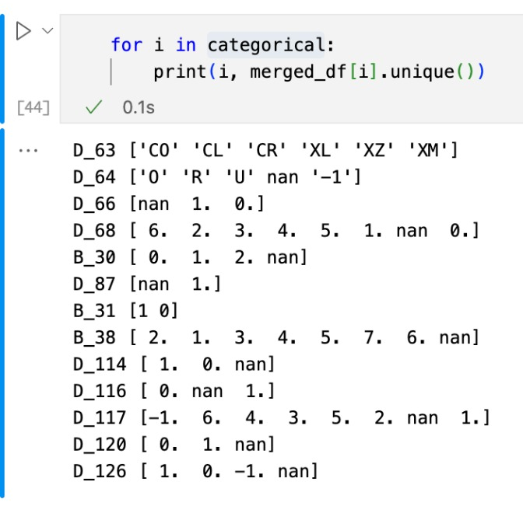
DATA PROCESSING- ONE HOT ENCODING
Categorical Variable
Unique Values
Categorical Variable | Unique Values
B_30 | [0, 1, 2, NaN]
B_38 | [3, 5, 1, 4, 6, 7, 2, NaN]
D_114 | [1, 0, NaN]
D_116 | [0, NaN, 1]
D_117 | [6, NaN, 1, 3, -1, 2, 4, 5]
D_120 | [0, NaN, 1]
D_126 | [1, 0, -1, NaN]
D_63 | [CO, CL, CR, XZ, XL, XM]
D_64 | [R, NaN, U, O, -1]
D_66 | [NaN, 1, 0]
D_68 | [5, NaN, 3, 4, 6, 1, 2, 0]

Slide 8
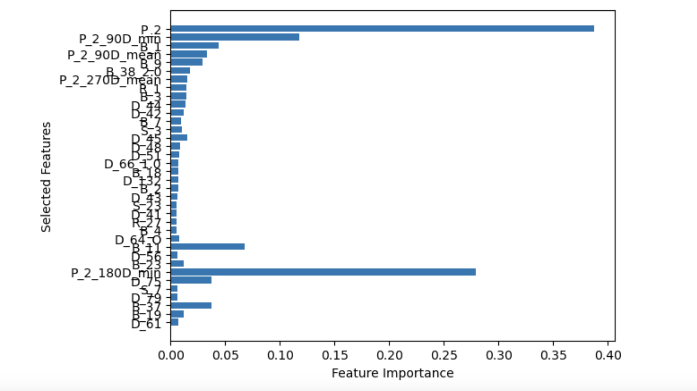
FEATURE SELECTION
The significance outlined by the original XGBoost model was utilized to choose which 40 features to include in the models. For a feature to be utilized, its importance has to be higher than the 0.5% threshold.
Category | # of Features | # of Features Selected
Delinquency (D_*) | 122 | 14
Spend (S_*) | 22 | 3
Payment (P_*) | 12 | 5
Balance (B_*) | 49 | 12
Risk (R_*) | 28 | 2

Slide 9
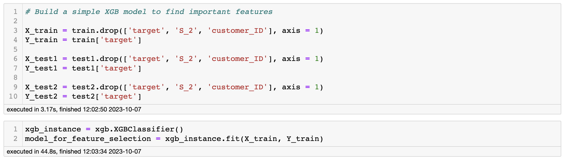
XGBoost – GRID SEARCH(Default Parameters)
Default parameters are employed in the initial XGBoost model for several reasons:
They provide a starting point for benchmarking against custom parameter configurations.
Default parameters help prevent potential overfitting, particularly when dealing with extensive datasets.
They make it easier to gain insights and understand the initial characteristics of the data before fine-tuning parameters.
Using default parameters can substantially cut down on computational time and resource demands when evaluating the initial dataset.

Slide 10
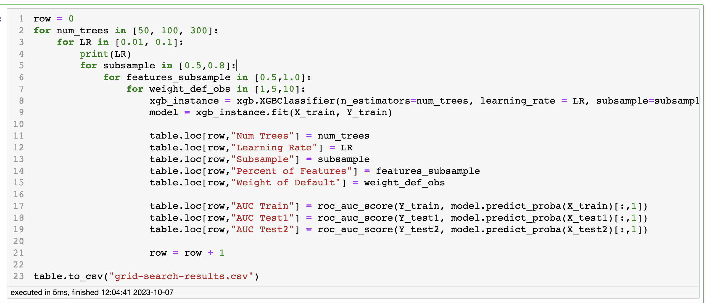
XGBoost – GRID SEARCH(Custom Parameters)
Custom parameters are employed in the XGBoost model for the following reasons:
By increasing the number of trees by 300, the model can now capture more intricate relationships in the data without requiring additional processing.
The use of a higher learning rate (0.5) is beneficial when dealing with a small dataset as it accelerates the model's ability to acquire new information quickly.
Setting a tree depth limit at 4 helps prevent overfitting and avoids creating overly complex trees.
Subsampling at a rate of 0.5 introduces randomness and diversity into the training process while mitigating the risks of overfitting that could occur with a higher learning rate.
Employing sample weights helps address any imbalances present in the dataset, ensuring a more robust and accurate model.

Slide 11
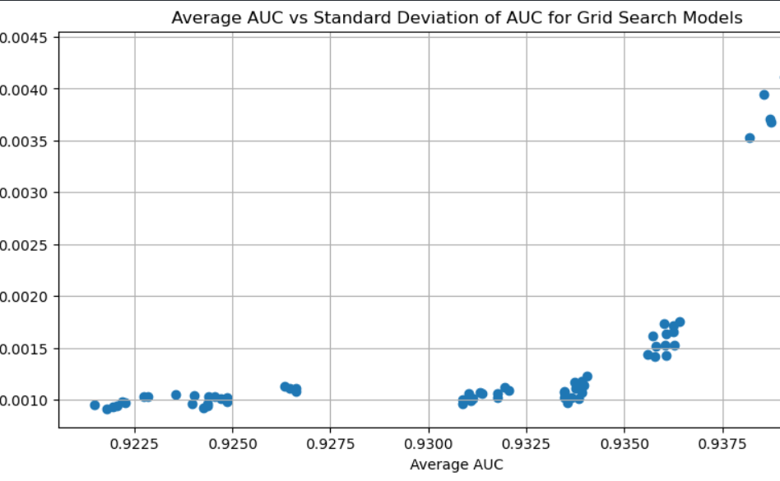
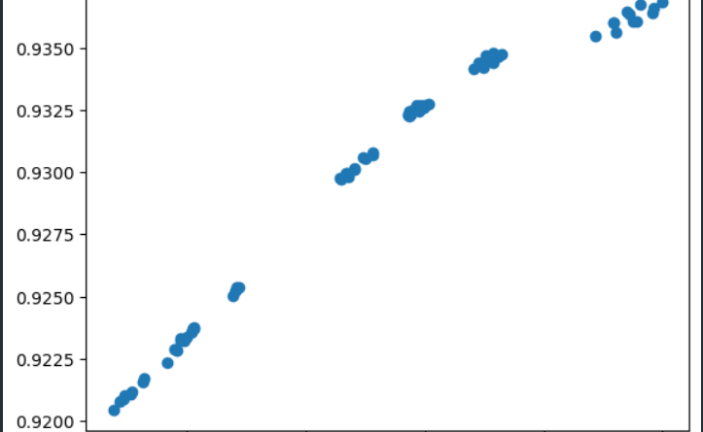
XGBoost – GRID SEARCH
To improve the model's predictability, the model with the greatest AUC and least variation between the train and test is picked.

Slide 12
XGBoost – FINAL MODEL(Parameters)
XGB – Best Model (lowest bias and variance)
Num Trees | 300
Learning Rate | 0.1
Subsample | 0.8
Percent of Features | 1
Weight of Default | 1
AUC Train | 0.944978
AUC Test1 | 0.936840
AUC Test2 | 0.938104

Slide 13
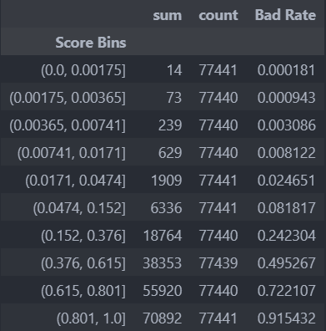
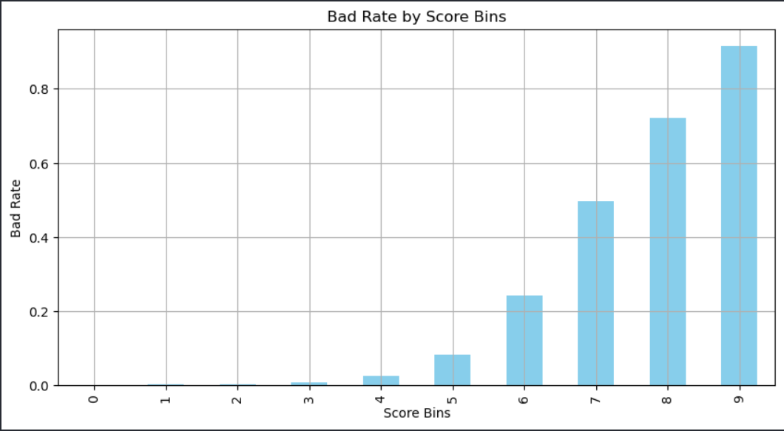
XGBoost – FINAL MODEL(Score Bins)

Slide 14
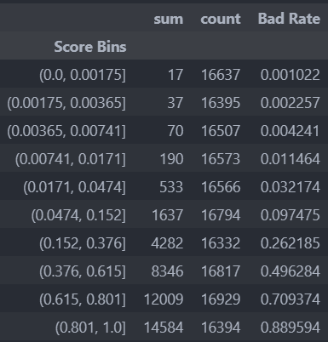
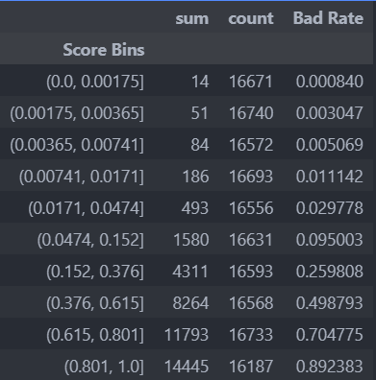
XGBoost – FINAL MODEL(Score Bins)
For Test (1) Sample:
For Test (2) Sample:

Slide 15
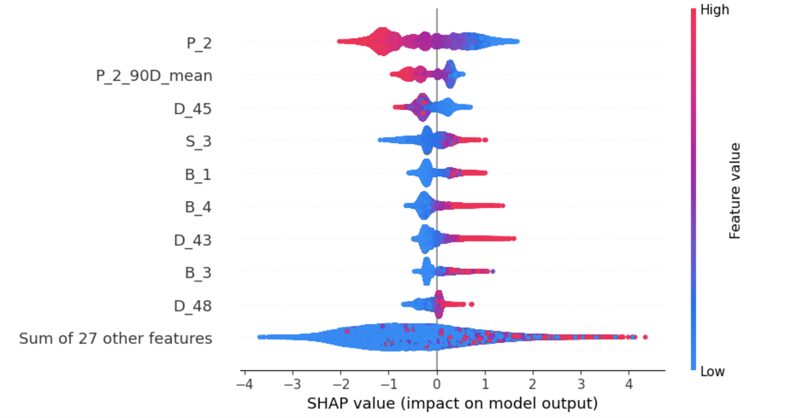
XGBoost – SHAP ANALYSIS (Beeswarm)
Beeswarm on Test 2 Sample:
Apart from P_2, majority of features with high feature values contribute positively to the prediction.
Among the top 9 features, 6 of them show a pattern where low feature values have a detrimental effect, especially when considering the cumulative features.
In the case of the cumulative features, there are instances of outliers where high feature values with high SHAP values positively influence the model's performance.

Slide 16
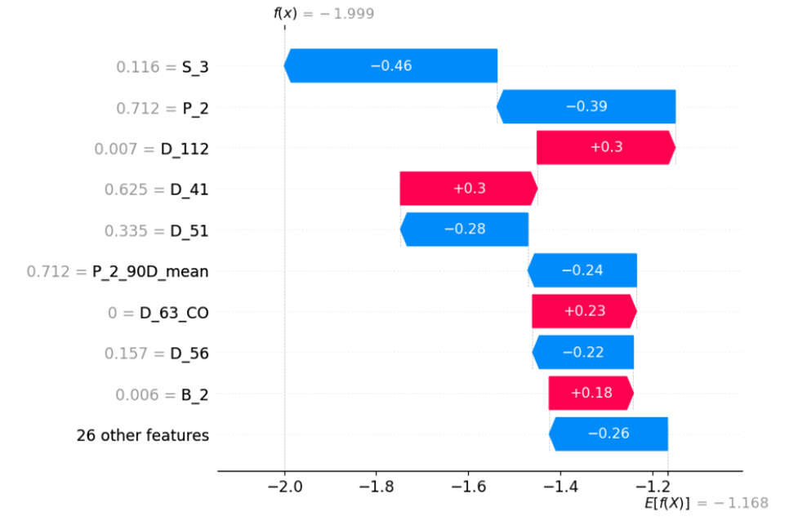
XGBoost – SHAP ANALYSIS (Waterfall)
•Waterfall Graph based on one observation in Test 2 Sample:
•S_3 is the most influential variable with a negative impact of 0.46
•Majority (6/9) of the top variables are negatively impacting the prediction.
•D_112 ,D_41 , D_63_COand B_2 are positively impacting the model’s prediction.
•Solutions to increase Score:
•Choose features that have a significant impact on the target variable and remove irrelevant or redundant features that might introduce noise.
•Optimize the hyperparameters of the machine learning model.
•Iterate on the model-building process to make incremental improvements.

Slide 17
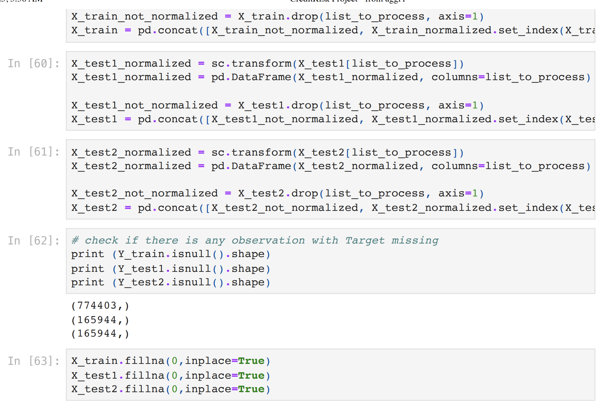
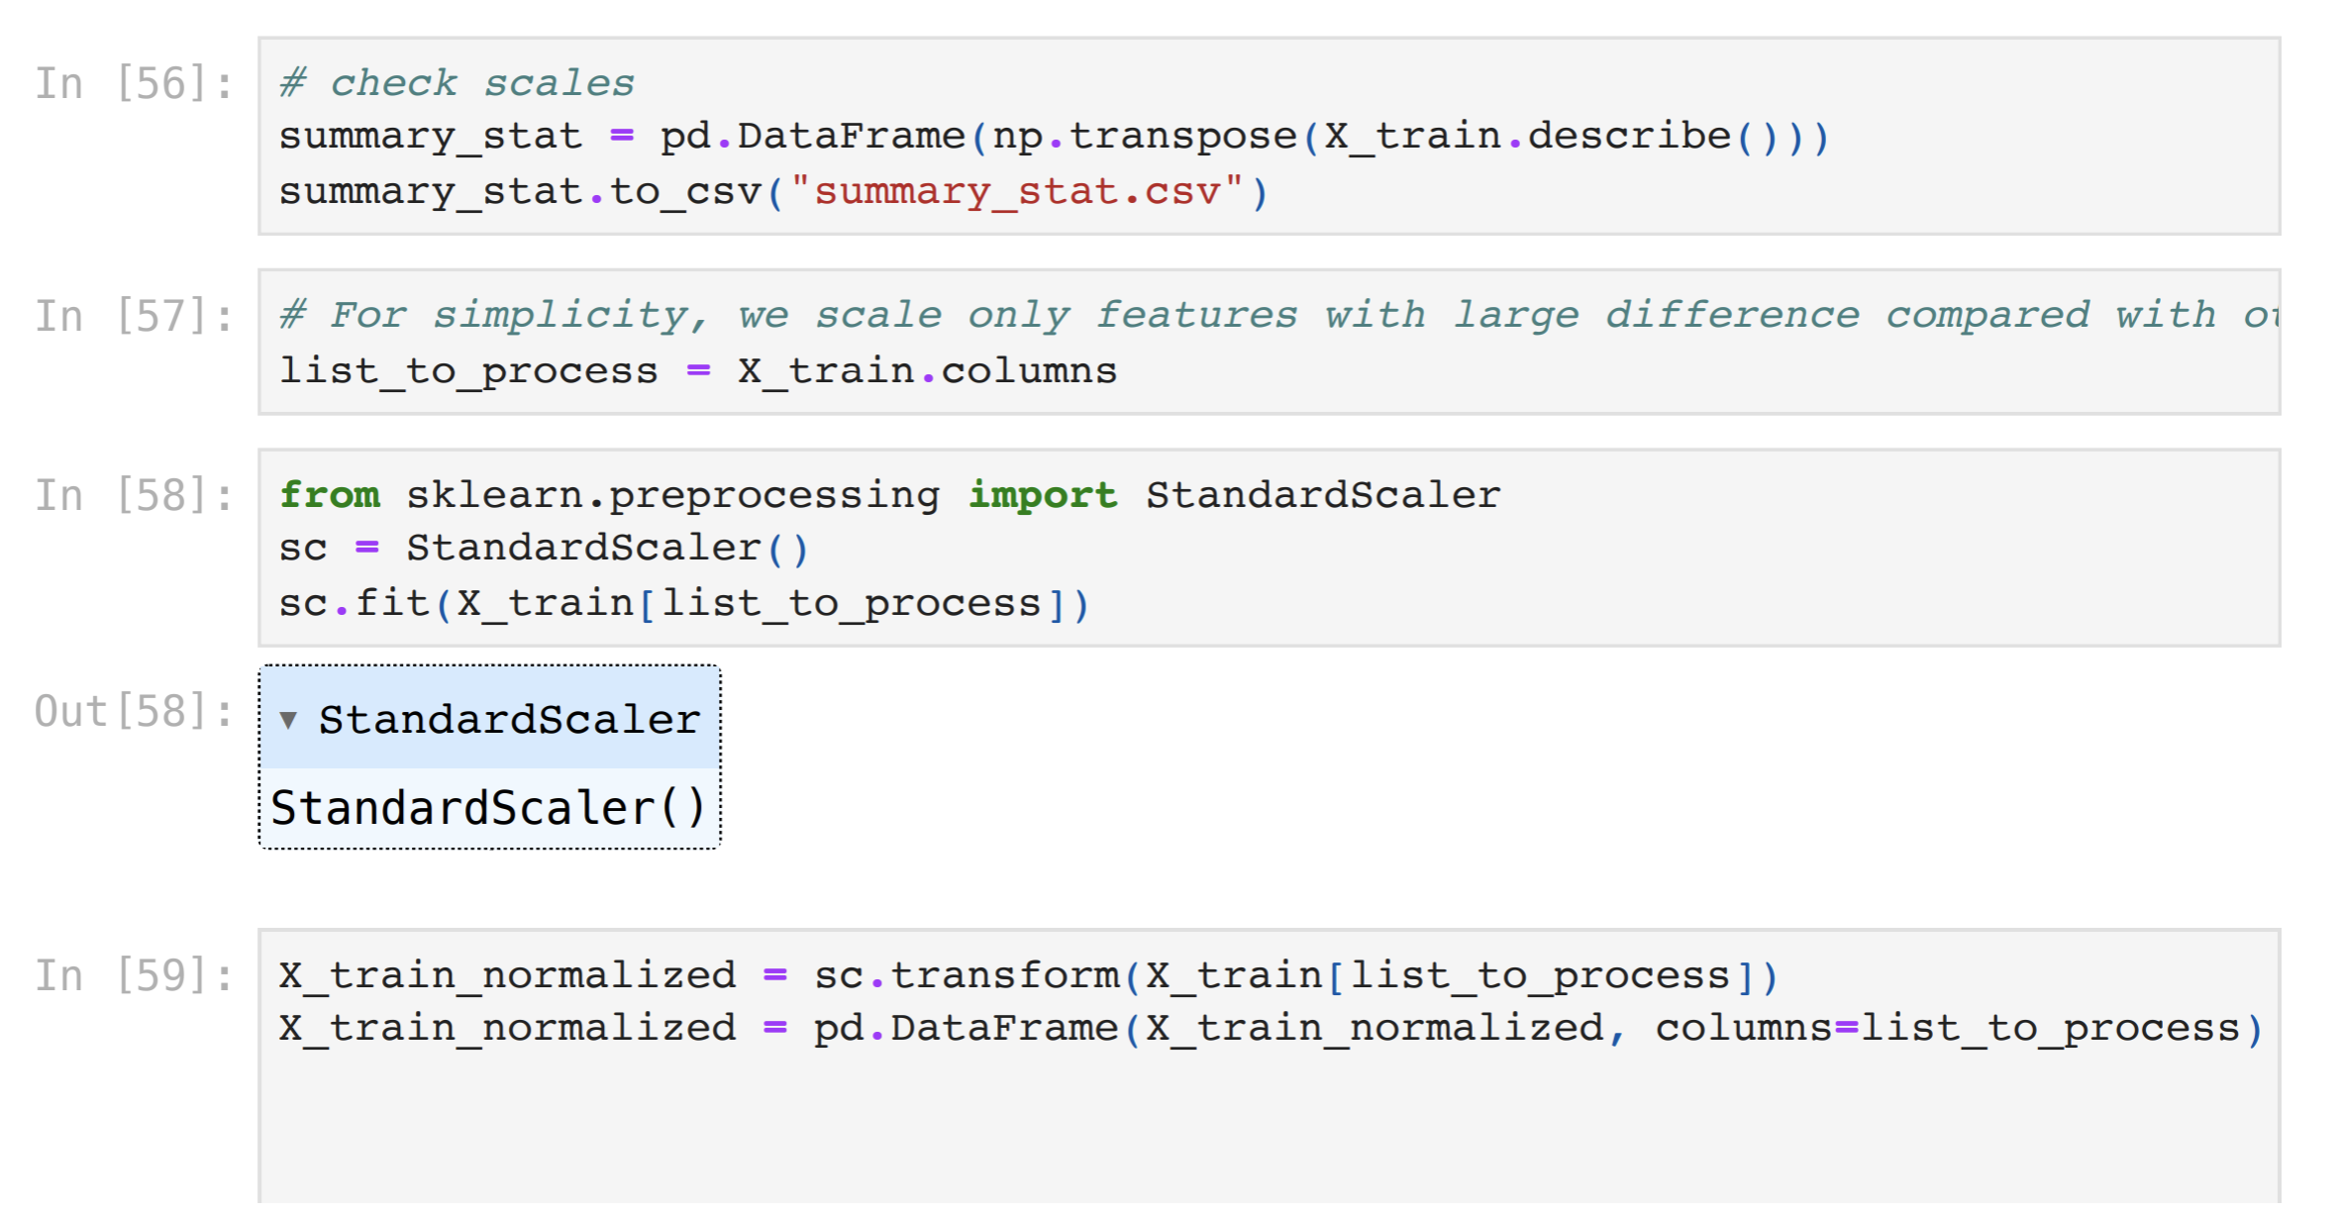
NEURAL NETWORK – DATA PROCESSING

Slide 18
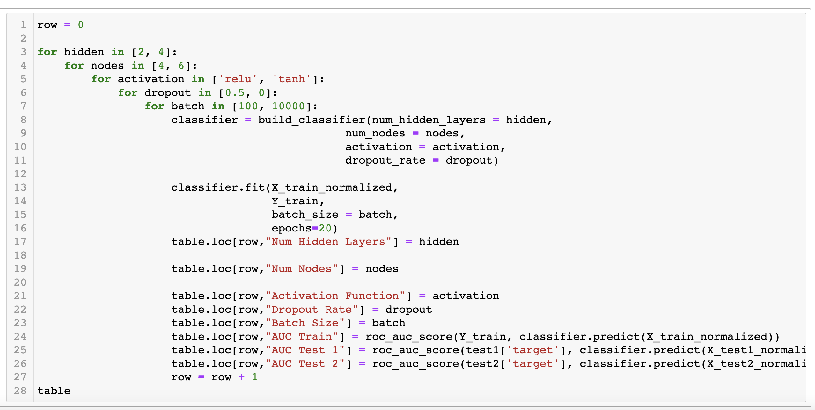
NEURAL NETWORK – GRID SEARCH
The objective of this function is to identify the model that achieves the highest average AUC score on the test datasets, while also maintaining low bias when trained and demonstrating consistent performance across different sets of test data.
A low variance suggests that the model does not excessively adjust to noise or random idiosyncrasies in the training data, thereby preventing overfitting.
A lack of low bias allows the model to capture subtle patterns in the data, ensuring that it accurately represents the underlying data distribution and avoids underfitting.

Slide 19
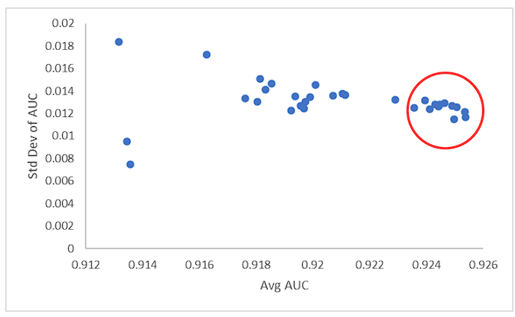
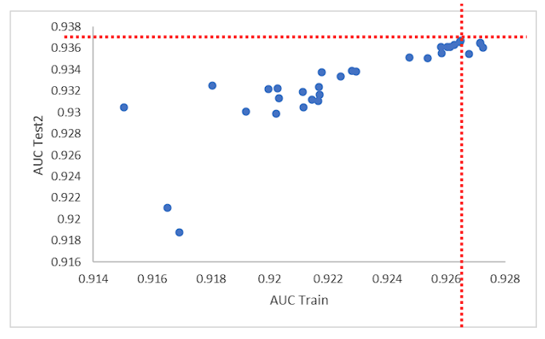
NEURAL NETWORK – GRID SEARCH
To enhance the model's predictive performance, we choose the model that exhibits both the highest average AUC score and the least variability between its performance on the training and test datasets.

Slide 20
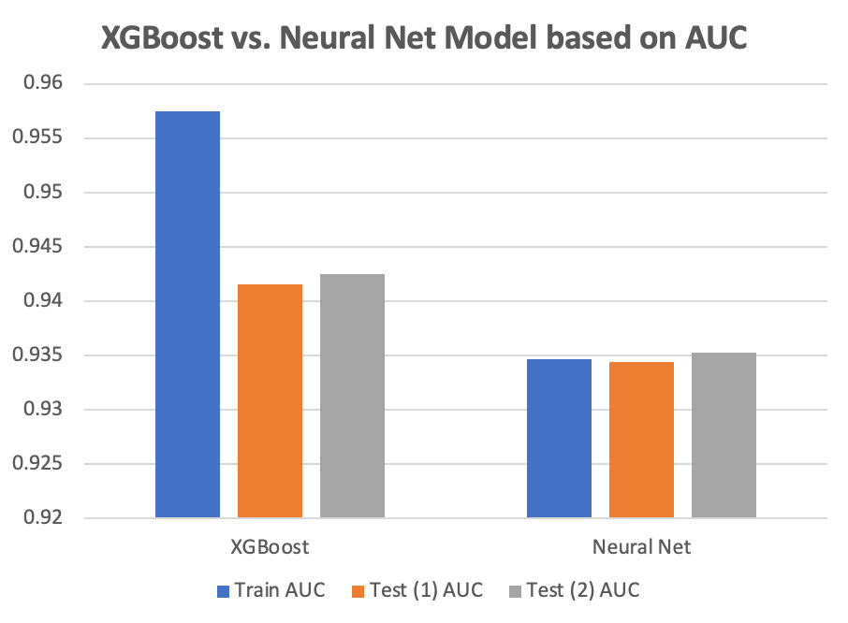
FINAL MODEL: XGBoost
To enhance the model's ability to make accurate predictions, we pick the model that achieves the highest average AUC and has the smallest difference in performance between the training and test datasets.
This implies that the model is likely to excel in categorizing data, leading us to expect it will predict more true positives (TP) and true negatives (TN) than false positives (FP) and false negatives (FN).
The model's precision is of utmost importance since it will directly influence the profitability of the portfolio.

Slide 21
STRATEGY
Results: The revenues are calculated per person per month, with balance variable B_2 and spend variable S_3 (from important features with helpful SHAP values) using XGB Final Model. MonthlyRevenue for 1 cust. = B_2_ave*0.02 + S_2_ave*0.001
We pick 0.3 for the conservative strategy (low default, high revenue), and 0.5 for aggressive strategy (default less than 10% as per company's requirements).
 | Train |  |  | Test 1 |  |  | Test 2
Threshold​ | # Total – accepted​ | Default Rate​ | Revenue​ | # Total – accepted​ | Default Rate​ | Revenue​ | # Total – accepted​ | Default Rate​ | Revenue​
0.1 | 33,736 | 1.65% | $ 1,129 | 7,085 | 1.68% | $ 1,118 | 7,374 | 1.65% | $ 1,129
0.2 | 77,620 | 3.20% | $ 1,199 | 16,300 | 2.95% | $ 1,187 | 16,966 | 3.20% | $ 1,199
0.3 | 117,456 | 4.37% | $ 1,237 | 24,666 | 4.60% | $ 1,224 | 25,672 | 4.37% | $ 1,237
0.4 | 153,014 | 6.11% | $ 1,264 | 32,133 | 6.04% | $ 1,250 | 33,444 | 6.10% | $ 1,264
0.5 | 185,135 | 8.05% | $ 1,283 | 38,878 | 8.00% | $ 1,272 | 40,465 | 8.05% | $ 1,283
0.6 | 215,403 | 10.37% | $ 1,301 | 45,235 | 10.32% | $ 1,290 | 47,081 | 10.37% | $ 1,301
0.7 | 245,813 | 13.13% | $ 1,317 | 51,621 | 13.19% | $ 1,303 | 53,728 | 13.31% | $ 1,317
0.8 | 279,972 | 16.90% | $ 1,328 | 58,794 | 16.80% | $ 1,315 | 61,194 | 16.90% | $ 1,328
0.9 | 328,664 | 21.19% | $ 1,333 | 69,019 | 21.08% | $ 1,322 | 71,837 | 21.20% | $ 1,333

Slide 22

Thank You!

